Slide 1
Welcome Back!
October 1, 2019
Academic Assembly

Slide 2
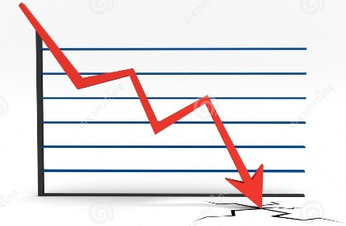
Fall Enrollment
College Wide as of 9/17/19:
Ammerman Michael J. Grant Eastern
2018 13,317 8,535 3,676
2019 12,697 -5% 8,077 -5% 3,438 -6%
Total -620 (N=251, C=369) -458 (N=201, C=257) -238 (N=63, C=175)
Prepared By Dean Saladino

Slide 3
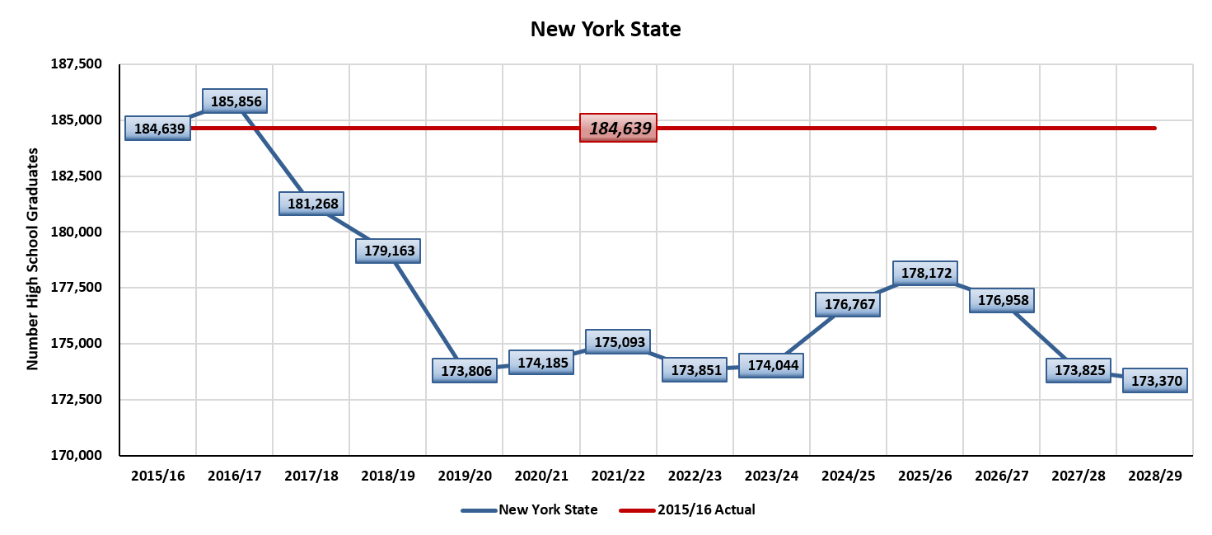
________Projected change in NYS high school graduates_________
Prepared By Dean Saladino
Notes:
National Center for Education Statistics

Slide 4
New Student Enrollment Yields
Semester | Applications | Enrolled | Yield
Fall 2016 | 4344 | 2764 | 64%
Fall 2017 | 4066 | 2557 | 63%
Fall 2018 | 4229 | 2616 | 62%
Fall 2019 | 4070 | 2407 | 60%
Spring 2016 | 1354 | 1027 | 75%
Spring 2017 | 1090 | 931 | 85%
Spring 2018 | 1297 | 916 | 70%
Spring 2019 | 1059 | 778 | 73%
Prepared By Dean Saladino

Slide 5
Retention: College-Wide Trends
The number of New students who did not return the following semester
Fall 2018 to Spring 2019 498
The number of Continuing students who did not return the following semester
Fall 2018 to Spring 2019 4093
Fall to Fall retention rates 2 year institutions nationally are 70.6%
SCCC is 67%
Prepared By Dean Saladino
Notes:
Once we enrolled students it is especially important now with our declining numbers that we retain them.
Here is just one semester to look at from Fall 2018 to Spring 2019. The numbers are College wide.
This is showing that we lost 498 new students who did not return the following Spring semester
And we lost 4,093 continuing students from Fall to spring

Slide 6

Summer Projects & Budget:
Line Painting $20K
TRIO Expansion
Kids Cottage Upgrades
Sagtikos Skill Center
Equipment & Supplies
Budget:
Flat awaiting final enrollment
New College CFO: October 7th

Slide 7

New Faculty & Administrators:
Ms. Marie Fils-Aime – Nursing Department
Mr. Robert Matarazzo – Criminal Justice, Social Science Department
Ms. Janine Muccio – Health Information Technology, Business & Technology Dept.
Mr. Keith Pardini – Librarian, Library Services
Ms. Jacqueline Stack – Nursing Department
Jason Cascone - Assistant Dean of Student Services / Director of Counseling
Melissa Adeyeye - Liberal Arts General Studies Program Administrator

Slide 8

Fall 2019 - 2020:
Dr. Donna Ciampa:
Social Science Department
English & Humanities Department
Communications & Arts Department
Academic and Advising Center
Master Schedule
STH Program (new program to support academically probation & dismissed students)
Humanities Center
Dr. Hector Sepulveda:
Natural Science Department
Allied Health Department
Mathematic Department
Physical Education Department
High School Program Outreach
Student Alert Program
Honors Program
Dean Elizabeth Spagnola:
Workforce Programs: MFT / HVAC
Business & Technology Department (now including Health Information Technology Program)
Transitional Studies (Coll 101, Reading, ESL Studies)
Liberal Arts General Studies
Academic Skill Center (LRC)

Slide 9

Year Ahead:
New Academic Programs
Wyandanch Extension Location
HSEC Name Change
Evaluate & Foster Mentoring & Support Programs
TLC Programs
Capital Project:
Sagtikos Renovation, Plant Operations & STEM
Asharoken Updates
Presidential Search

